Slide 1
Module 5:
Large-Scale Machine Learning (UnSupervised)

Slide 2
Agenda
Introduction
Introduction to Large-Scale UnSupervised Machine Learning
Gaussian Mixture Models
Introduction to Gaussian Mixture Models
Examples
Dimensionality Reduction
Concept of Support Vector Machines, Advantages & Disadvantages
Examples
PySpark, ML Library
K-Means
K-Means Clustering Problem
Algorithm, Examples
Examples of DT, NB, SVM, and kNN using PySpark
Exercises

Slide 3
Introduction
What is Cluster Analysis?
Cluster: a collection of data objects
  Similar to one another within the same cluster
  Dissimilar to the objects in other clusters
Cluster analysis
  Finding similarities between data according to the characteristics found in the data and grouping similar data objects into clusters
Unsupervised learning: no predefined classes
Typical applications
  As a stand-alone tool to get insight into data distribution
  As a preprocessing step for other algorithms

Slide 4

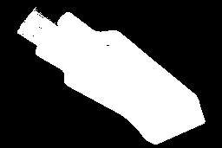
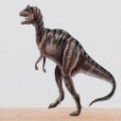
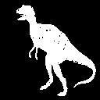
Example – Image Segmentation
Original k = 2
k = 2 k = 3

Slide 5
Clustering: Rich Applications and Multidisciplinary Efforts
Pattern Recognition
Spatial Data Analysis
  Create thematic maps in GIS by clustering feature spaces
  Detect spatial clusters or for other spatial mining tasks
Digital Image Processing
Economic Science (especially market research)
WWW
  Document classification
  Cluster Weblog data to discover groups of similar access patterns

Slide 6
Examples of Clustering Applications
Marketing: Help marketers discover distinct groups in their customer bases, and then use this knowledge to develop targeted marketing programs
Land use: Identification of areas of similar land use in an earth observation database
Insurance: Identifying groups of motor insurance policy holders with a high average claim cost
City-planning: Identifying groups of houses according to their house type, value, and geographical location
Earth-quake studies: Observed earth quake epicenters should be clustered along continent faults

Slide 7
Quality: What Is Good Clustering?
A good clustering method will produce high quality clusters with
  high intra-class similarity
  low inter-class similarity
The quality of a clustering result depends on both the similarity measure used by the method and its implementation
The quality of a clustering method is also measured by its ability to discover some or all of the hidden patterns

Slide 8
Measure the Quality of Clustering
Dissimilarity/Similarity metric: Similarity is expressed in terms of a distance function, typically metric: d(i, j)
There is a separate “quality” function that measures the “goodness” of a cluster.
The definitions of distance functions are usually very different for interval-scaled, boolean, categorical, ordinal ratio, and vector variables.
Weights should be associated with different variables based on applications and data semantics.
It is hard to define “similar enough” or “good enough”
  the answer is typically highly subjective.

Slide 9
Requirements of Clustering
Scalability
Ability to deal with different types of attributes
Ability to handle dynamic data
Discovery of clusters with arbitrary shape
Minimal requirements for domain knowledge to determine input parameters
Able to deal with noise and outliers
Insensitive to order of input records
High dimensionality
Incorporation of user-specified constraints
Interpretability and usability

Slide 10
Major Clustering Approaches
Partitioning approach
  Construct various partitions and then evaluate them by some criterion, e.g., minimizing the sum of square errors
  Typical methods: k-means, k-medoids, CLARANS
Hierarchical approach
  Create a hierarchical decomposition of the set of data (or objects) using some criterion. Uses bottom-up approach. i.e. each object is a group and merge similar groups.
  Typical methods: Diana, Agnes, BIRCH, ROCK, CAMELEON
Density-based approach
  Based on connectivity and density functions
  Cluster based on distance between objects
  Typical methods: DBSACN, OPTICS, DenClue

Slide 11
Major Clustering Approaches…
Grid-based approach
  Quantize the object space into finite number of cells - grid
  Typical methods: STING, WaveCluster, CLIQUE
Model-based
  A model is hypothesized for each of the clusters and tries to find the best fit of that model to each other
  Typical methods: EM, SOM, COBWEB
Frequent pattern-based
  High dimensional clustering – documents may contain thousands of features
  Based on the analysis of frequent patterns
  Typical methods: pCluster
User-guided or constraint-based
  Clustering by considering user-specified or application-specific constraints
  Typical methods: COD (obstacles), constrained clustering

Slide 12
Data Structures
Data for clustering may contain n objects, which represent persons, houses, documents, countries, and so on..
Data matrix
  (two modes, n x p)
  i.e. n objects and p variables
Dissimilarity matrix
  (one mode)
  object by object, n x n
  D(i, j) – measured dissimilarity

Slide 13
Dissimilarity Matrix
Binary variables: We often face variables that only binary value such as Yes and No, or Agree and Disagree, True and False, Success and Failure, 0 and 1, Absence or Present, Positive and Negative, etc.
For such binary variables, there are only two possible values, which can be represented as positive and negative.
Similarity of dissimilarity (distance) of two objects that represented by binary variables can be measured in term of number of occurrence (frequency) of positive and negative in each object.
Fruit Sweet Sour Crunchy
Object i =Apple Yes Yes Yes
Object j =Banana Yes No No
3D Vector for Apple(1,1,1) and for Banana(1,0,0)

Slide 14
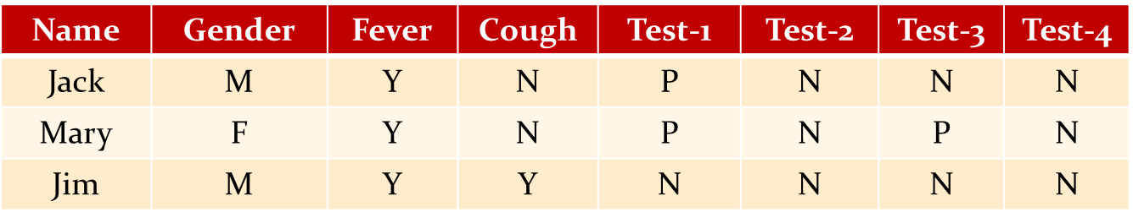
Example
p = number of variables that positive for both objects
q = number of variables that positive for the ith objects and negative for the jth object
r = number of variables that negative for the ith objects and positive for the jth object
s = number of variables that negative for both objects
t = total number of variables
Jaccard’s distance = (q + r)/(p+q+r)
d(Jack, Mary) = (0+1) / (2+0+1) = 0.33
d(Jack, Jim) = (1+1) / (1+1+1) = 0.67
d(Mary, Jim) = (1+2) / (1+1+2) = 0.75
Mary and Jim are unlikely to have same disease – 0.75
Jack and Mary are most likely to have the same disease – 0.33
 |  | Object j
 |  | Yes | No
Object i | Yes | p | q
 | No | r | s

Slide 15
Partitioning Algorithms: Basic Concept
Partitioning method
  Construct a partition of a database D of n objects into a set of k clusters, where k ≤ n where each partition represents a cluster
Given a k, find a partition of k clusters that optimizes the chosen partitioning criterion
  Global optimal: exhaustively enumerate all partitions
  Heuristic methods: k-means and k-medoids algorithms
  k-means : Each cluster is represented by the center of the cluster
  k-medoids: Each cluster is represented by one of the objects in the cluster

Slide 16
The k-Means Clustering Method
Given k, the k-means algorithm is implemented in the following way:
  Algorithm k-means
  // k - no. of clusters
  // D – data set containing n objects
  Arbitrarily choose k objects from D as the initial clusters
  Repeat
    (re)assign each object to the cluster to which the object is the most similar, based on the mean value of the objects in the cluster
    Update the cluster means. i.e. calculate the mean value of the objects for each cluster
  Until no change

Slide 17
The K-Means Clustering Method
Example
10
10
9
9
8
8
7
7
6
6
5
5
4
Assign each objects to most similar center
Update the cluster means
4
3
3
2
2
1
1
0
0
0
1
2
3
4
5
6
7
8
9
10
0
1
2
3
4
5
6
7
8
9
10
reassign
reassign
k=2
Arbitrarily choose k object as initial cluster center
Update the cluster means

Slide 18
Numeric Example
Problem: Cluster the following eight points (with (x, y) representing locations) into three clusters:
A1(2, 10) A2(2, 5) A3(8, 4) A4(5, 8)
A5(7, 5) A6(6, 4) A7(1, 2) A8(4, 9).
Initial cluster centers are: A1(2, 10), A4(5, 8) and A7(1, 2)
The distance function between two points a = (x1, y1) and b=(x2, y2) is defined as:
  ρ(a, b) = |x2 – x1| + |y2 – y1|
Use k-means algorithm to find the three cluster centers after the second iteration.

Slide 19
K-Means Example
Given: {2,4,10,12,3,20,30,11,25}, k = 2
Randomly assign means: m₁=3, m₂=4
K₁={2,3}, K₂={4,10,12,20,30,11,25}, m₁=2.5, m₂=16
K₁={2,3,4}, K₂={10,12,20,30,11,25}, m₁=3, m₂=18
K₁={2,3,4,10}, K₂={12,20,30,11,25}, m₁=4.75, m₂=19.6
K₁={2,3,4,10,11,12}, K₂={20,30,25}, m₁=7, m₂=25
Stop as the clusters with these means are the same.

Slide 20
Example - 2
A1(2, 10), A2(2, 5), A3(8, 4), A4(5, 8), A5(7, 5), A6(6, 4) A7(1, 2), A8(4, 9).
k = 3
Initial cluster centers are: A1(2, 10), A4(5, 8) and A7(1, 2)
Iteration – 1
K1 = {A1}, K2 = {A3,A4,A5,A6,A8}, K3 = {A2,A7}
m1 = (2, 10), m2 = (6, 6), m3 = (1.5, 3.5)
 | Point | (2, 10) | (5, 8) | (1, 2) | Cluster
A1 | (2, 10) | 0 | 5 | 9 | 1
A2 | (2, 5) | 5 | 6 | 4 | 3
A3 | (8, 4) | 12 | 7 | 9 | 2
A4 | (5, 8) | 5 | 0 | 10 | 2
A5 | (7, 5) | 10 | 5 | 9 | 2
A6 | (6, 4) | 10 | 5 | 7 | 2
A7 | (1, 2) | 9 | 10 | 0 | 3
A8 | (4, 9) | 3 | 2 | 10 | 2

Slide 21
Example-2 (Contd…)
Iteration – 2
K1 = {A1, A8}, K2 = {A3,A4,A5,A6}, K3 = {A2,A7}
m1 = (3, 9.5), m2 = (6.5, 5.25), m3 = (1.5, 3.5)
 | Point | (2, 10) | (6, 6) | (1.5, 3.5) | Cluster
A1 | (2, 10) | 0 | 8 | 7 | 1
A2 | (2, 5) | 5 | 5 | 2 | 3
A3 | (8, 4) | 12 | 4 | 8 | 2
A4 | (5, 8) | 5 | 3 | 8 | 2
A5 | (7, 5) | 10 | 2 | 7 | 2
A6 | (6, 4) | 10 | 2 | 5 | 2
A7 | (1, 2) | 9 | 9 | 2 | 3
A8 | (4, 9) | 3 | 5 | 8 | 1

Slide 22
Example -2 (Contd…)
Iteration – 3
K₁ = {A1, A4, A8}, K₂ = {A3,A5,A6}, K₃ = {A2,A7}
m₁ = (3.66, 9.0), m₂ = (7.0, 4.33), m₃ = (1.5, 3.5)
 | Point | (3, 9.5) | (6.5, 5.25) | (1.5, 3.5) | Cluster
A1 | (2, 10) | 1.5 | 9.25 | 7.0 | 1
A2 | (2, 5) | 5.5 | 4.75 | 3.0 | 3
A3 | (8, 4) | 10.5 | 3.75 | 8.0 | 2
A4 | (5, 8) | 3.5 | 4.75 | 10.0 | 1
A5 | (7, 5) | 8.5 | 1.75 | 9.0 | 2
A6 | (6, 4) | 8.5 | 1.75 | 6.0 | 2
A7 | (1, 2) | 9.5 | 8.75 | 2.0 | 3
A8 | (4, 9) | 1.5 | 7.75 | 10.0 | 1

Slide 23
Comments on the k-Means Method
Strength: Relatively efficient: O(tkn), where n is # objects, k is # clusters, and t is # iterations. Normally, k, t << n.
Comment: Often terminates at a local optimum. The global optimum may be found using techniques such as: deterministic annealing and genetic algorithms
Weakness
  Applicable only when mean is defined, then what about categorical data?
  Need to specify k, the number of clusters, in advance
  Unable to handle noisy data and outliers
  Not suitable to discover clusters with non-convex shapes

Slide 24
Gaussian Mixture Models (GMM)
Have you ever wondered how machine learning algorithms can effortlessly categorize complex data into distinct groups?
Imagine blending multiple Gaussian distributions to form a single model. This is precisely what a Gaussian Mixture Model does.
What is Gaussian distribution or Normal Distribution?
It is a probability distribution that is symmetric about the mean, showing that data near the mean are more frequent in occurrence than data far from the mean (Bell Curve).
GMM operates on the principle that a complex, multi-modal distribution can be approximated by a combination of simpler Gaussian distributions, each representing a different cluster within the data.
The mean of each Gaussian component gives us a central point, around which the data points are most densely clustered - mean, variance, and weight.

Slide 25
Model Representation
At its core, a GMM is a combination of several Gaussian components.
These components are defined by their mean vectors, covariance matrices, and weights, providing a comprehensive representation of data distributions.
The probability density function of a GMM is a sum of its components, each weighted accordingly.
Notation:
  K: Number of Gaussian components
  N: Number of data points
  D: Dimensionality of the data
GMM Parameters:
  Means (μ): Center locations of Gaussian components.
  Covariance Matrices (Σ): Define the shape and spread of each component.
  Weights (π): Probability of selecting each component.

Slide 26
Implementation of GMM
In PySpark
class pyspark.ml.clustering.GaussianMixture(
*,
featuresCol: str = 'features',
predictionCol: str = 'prediction',
k: int = 2,
probabilityCol: str = 'probability',
tol: float = 0.01,
maxIter: int = 100,
seed: Optional[int] = None,
aggregationDepth: int = 2,
weightCol: Optional[str] = None)

Slide 27
Use Cases of Gaussian Mixture Models
Anomaly Detection: Identifying unusual data patterns.
Image Segmentation: Grouping pixels in images based on color or texture.
Speech Recognition: Assisting in the recognition of phonemes in audio data.
Handwriting Recognition: Simulating different handwriting styles.
Customer Segmentation: Grouping customers with similar behaviors or preferences.
Data Clustering: Finding natural groups in data.
Computer Vision: Object detection and background removal.
Bioinformatics: Analyzing gene expression data.
Recommendation Systems: Personalizing user experiences.
Medical Imaging: Tissue classification and abnormality detection.
Finance: Asset price modeling and risk management.

Slide 28
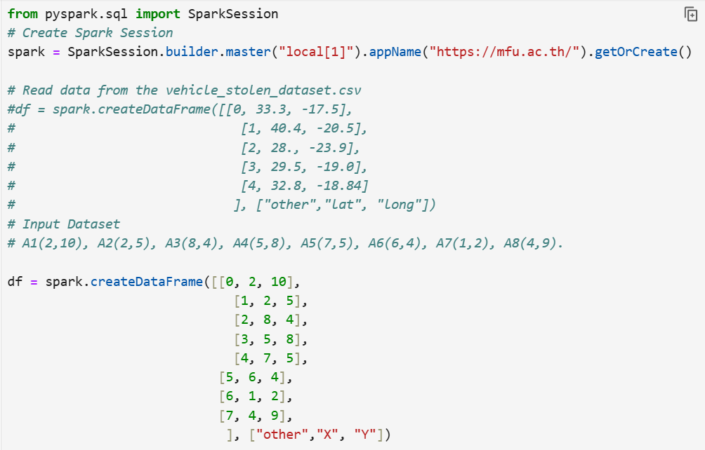
K-Means using PySpark

Slide 29
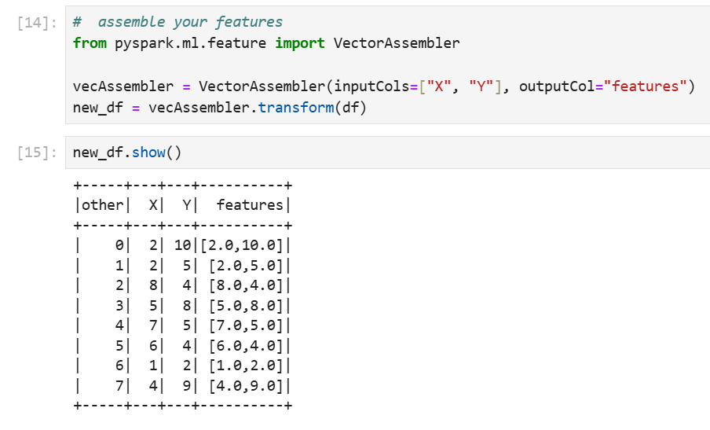
Contd…

Slide 30
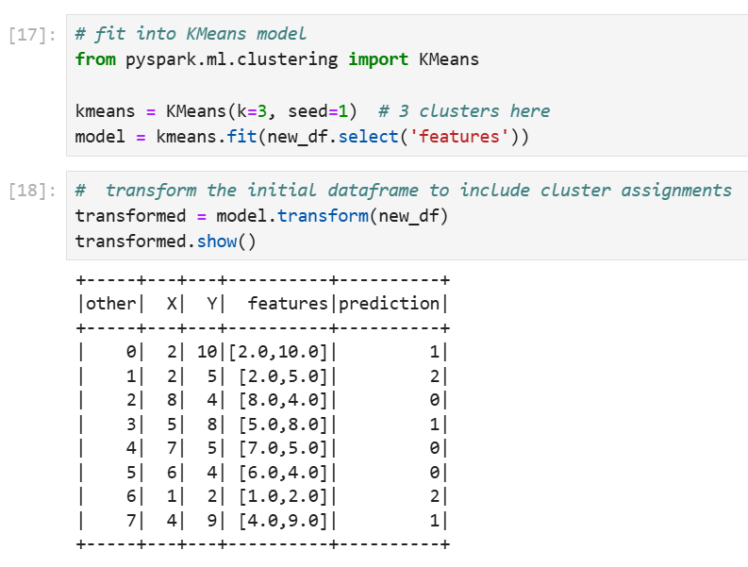
Contd…

Slide 31
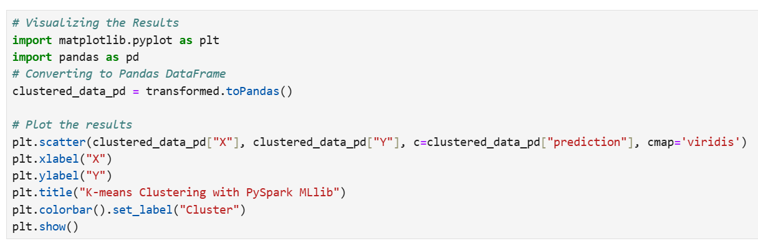
Contd…

Slide 32
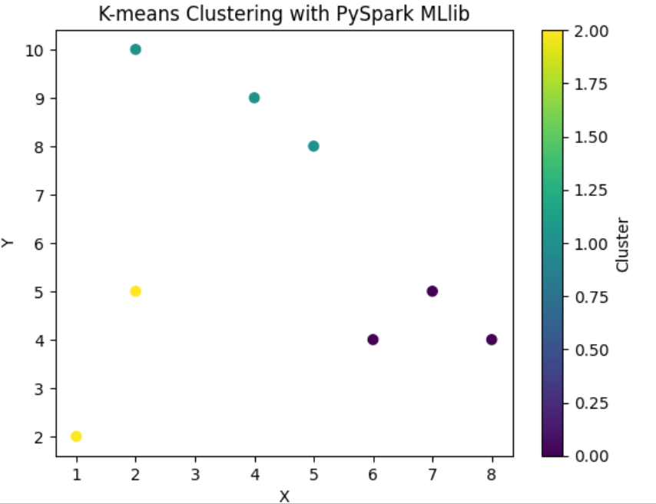
Contd…

Slide 33
Thank You

